Slide 1
Smart Sewage Detection & Monitoring System
Presented & Documented by:
Vivek Chauhan

Slide 2
Addressing the Critical and unnoticed problem
In recent years , cities have incurred numerous instances of flood damage from intense localized rainfalls.
The clogged sewers and thus overflowing sewer water leading to breeding of mosquitoes and several other water -borne diseases.
Hazardous and industrial solid wastes and gaseous fumes are dangerous to our health.
The change of area use has been encountered in several cases.
Theft of manhole covers .

Slide 3
Working towards creating society a better place..
Detection of points of failure and leakage.
Using less human intervention .
Communication of point of failure and risk analysis.
Automated monitoring of wastes generated .
Keeping track of the quality and quantity of wastes generated.

Slide 4
SSDMS:
To equip manholes with sensors that communicate through gateway to remotely located servers ,that can measure water levels, detect ph ,and oil per water ppm ,the soap lathers used in industries and use of sensitive ion electrode based sensors that can detect certain explosive chemicals in sewage by deploying sensors throughout the sewer line infrastructure keeping in mind topological and geographical considerations. It will accurately detect and constantly ping the server with the analysed data and even notify the warning levels ,to further reduce the human interdependence for fault detection and communication.

Slide 5
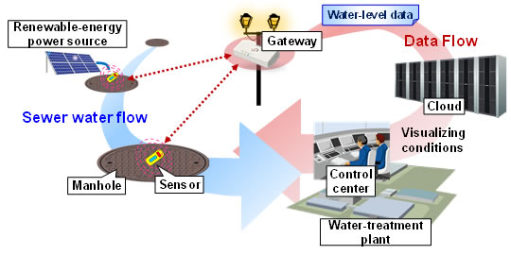
Figure.1 Example of real-time sewer water level monitoring system using ICT

Slide 6
Why it can be a big breakthrough…
It can help in regularising the area use as it give detailed analysis of type of waste.
With increasing terror threats ,it is a way to detect the use of sights of chemicals used for makings explosive.
It is solar powered thus increasing power efficiency.
It can be easily extended back and forth for extending area under its use.
It can be centrally monitored and regulated.
The health and hygiene of people can be improved

Slide 7
Who we can target:
The govt. of India with its smart city initiative would surely need to make its sewage management system more robust ,intelligent and independent.
The upcoming real estate markets are sure to attract these smart sewage systems in their societies.
The use of area is to be monitored and for these it becomes handy to small societies.

Slide 8
How many we are catering:
The no. of manholes in Delhi-NCR region are estimated to be between 2lac to 3lac and considering 1lac being in favourable topological and geographical conditions and similarly for other growing cities. .
The accuracy and sensitivity of data can be varied largely by number of sensors deployed .
The market size is expected to be around 1 to 5 crores per city at initial stages with tremendous growth capabilities.

Slide 9
Our way forward:
We intend to make a small residential societies sewerage system to be inspired by this idea and carrying with the successful working of this system forward.
We plan to make people aware by organising campaigns .
We plan to raise health and hygiene awareness among people.
We plan to get associated with Swach Bharat Abhiyan and Smart City Initiative.

Slide 10
Thank you

